Slide 1
Lesson 6 Practice Hands-On
mtcars
Adia Lewis
053021

Slide 2
Code Written
head(mtcars)
library(ggplot)
ggplot(data = mtcars, aes(x = cyl, y = mpg, group = cyl)) +
geom_boxplot(aes(y = mpg, x = cyl))
mtcars %>% group_by(cyl) %>% summarize(mean = mean(mpg))

Slide 3
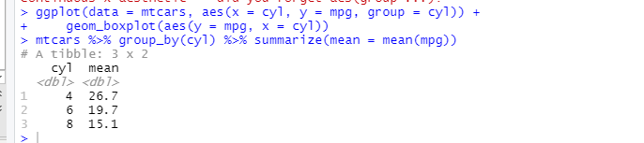
Console

Slide 4
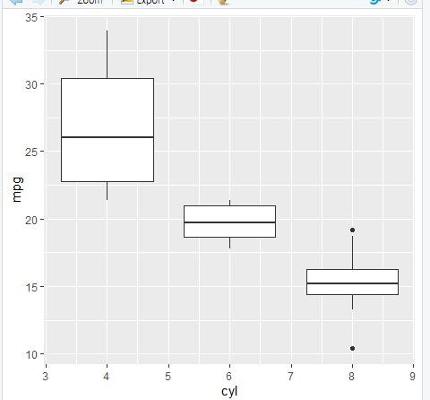
Box Plot
Data frame mtcars
Box plot mpg
Groped by # of cylinders in the engine
Summarized with by groups 4, 6, & 8 cylinders.

